Slide 1
UPI-Based Water Dispenser

Slide 2
ABSTRACT
The UPI-based water dispenser leverages Unified Payments Interface (UPI) for secure, cashless transactions, ensuring easy access to clean water. It features a user-friendly interface, robust security, and scalable design. The project includes comprehensive development, deployment, and ongoing improvements.

Slide 3
INTRODUCTION :
A UPI-based water dispenser integrates digital payment via Unified Payments Interface (UPI) for a seamless, cashless transaction experience. It aims to provide convenient access to clean water through a secure and user-friendly system with the help of GSM 4G module, I2C module etc...

Slide 4
COMPONENTS:
Submersible pump Relay
Pipe
Lcd
I2c module
Gsm 4g module
Bread board
Buzzer
Switch

Slide 5
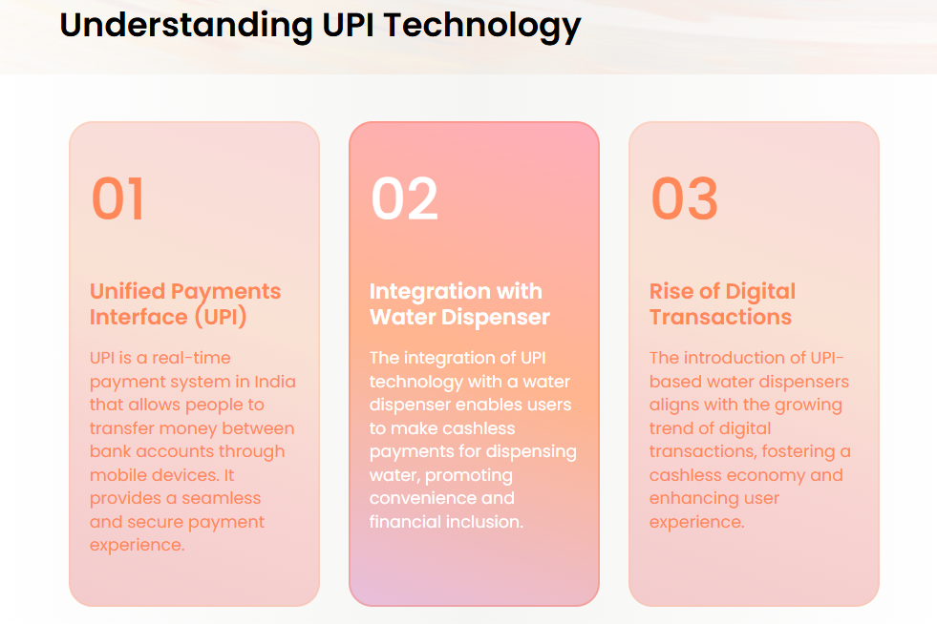
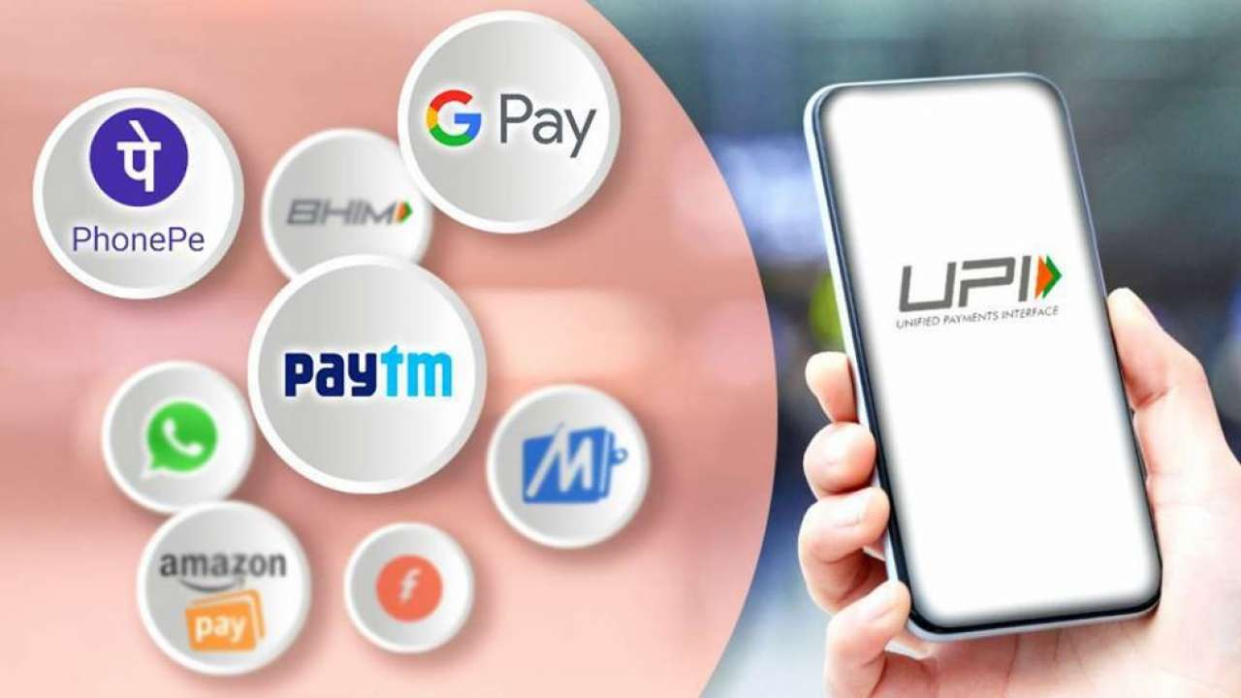
3

Slide 6
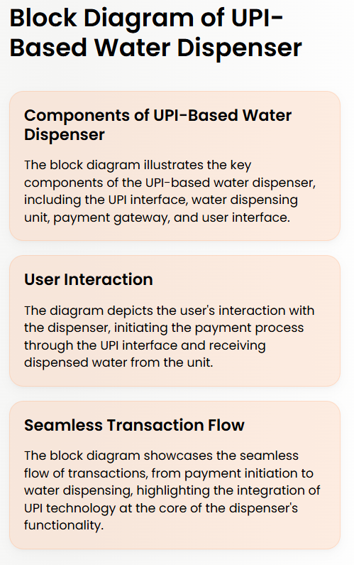
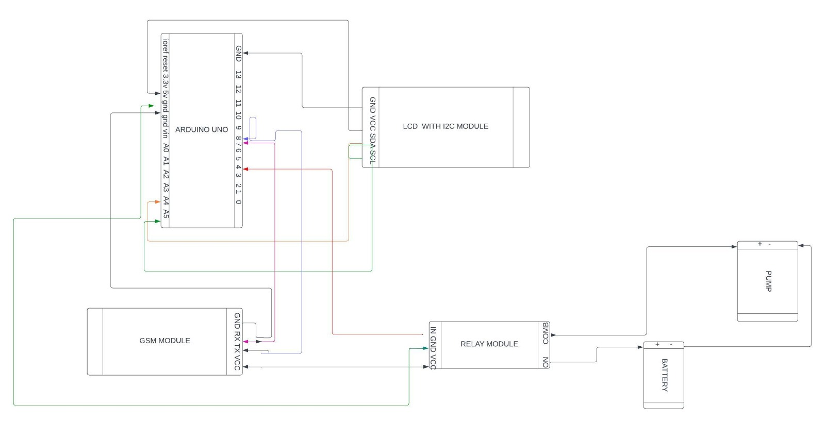
4
BLOCK DIAGRAM :

Slide 7
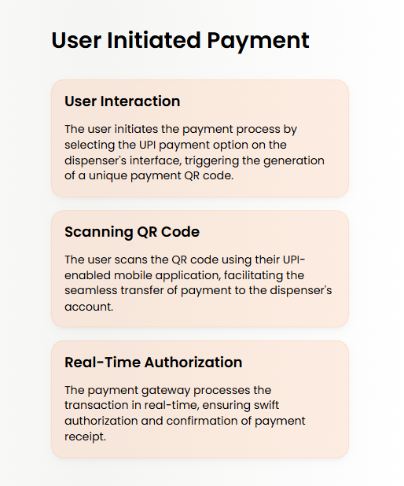
5

Slide 8
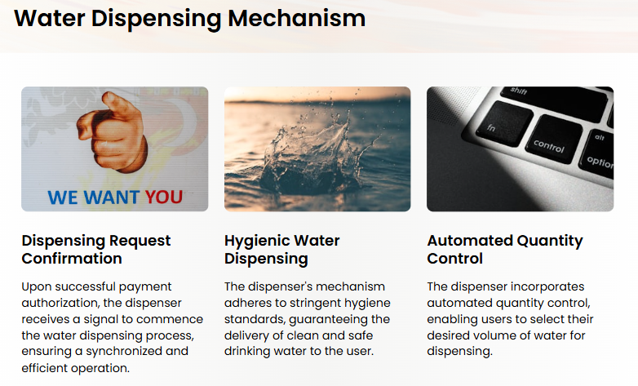

Slide 9
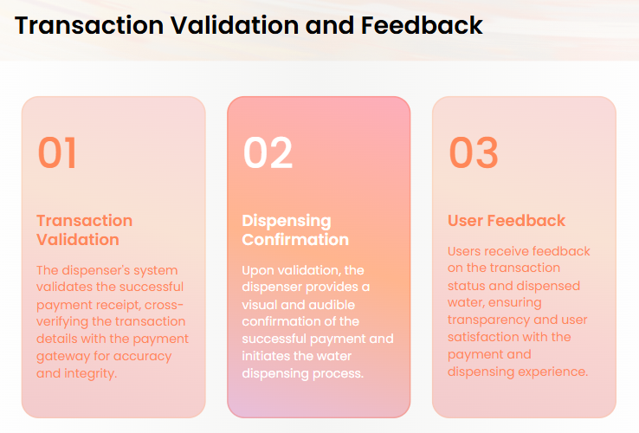

Slide 10
REAL TIME APPLICATIONS:
Public Places
Corporate Offices
Smart Cities
Hospitals and Clinics
Educational Institutions

Slide 11
Thank you

